Slide 1



BIM Virtual Reality (VR) & Augmented Reality (AR)
Christopher Huebner
Saturday, October 19th – 3:15-4:00pm

Slide 2


Slide 3
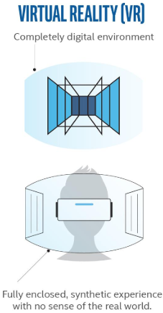
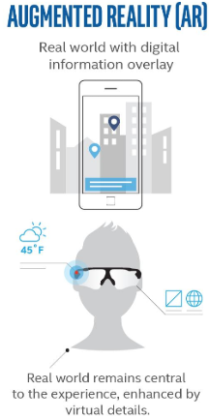
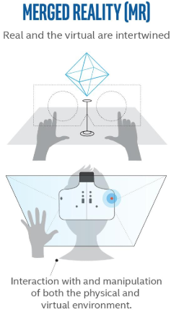
Virtual Reality (VR) vs Augmented Reality (AR) vs Merged Reality (MR)

Slide 4
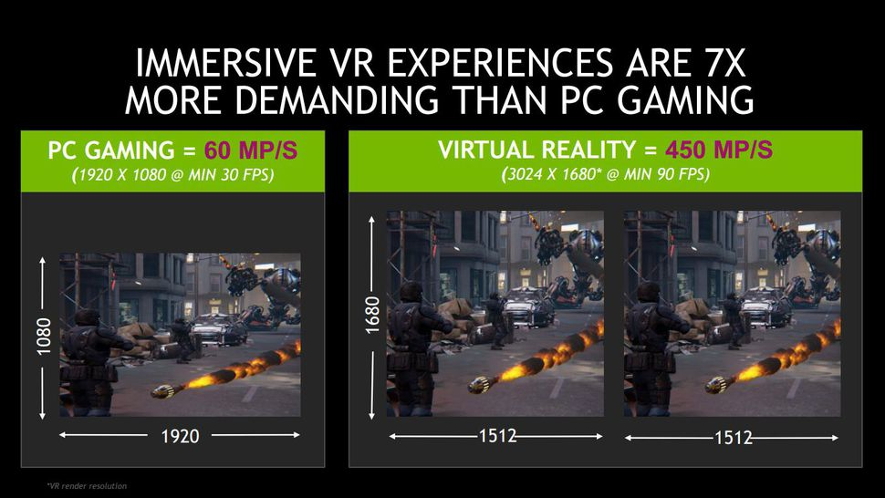

Slide 5
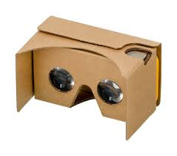
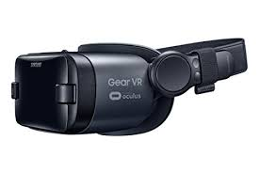
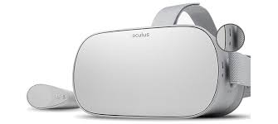
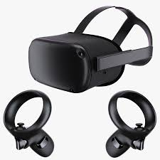
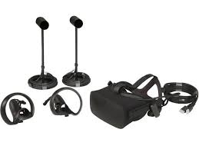
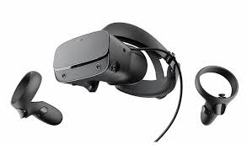
Virtual Reality Headsets
Google Cardboard
Samsung Gear VR
Oculus Go
Oculus Rift
Oculus Rift S
Oculus Quest

Slide 6







VR Software
Animation Software

Slide 7


Virtual Reality Workflows

Slide 8
Enscape Demo

Slide 9
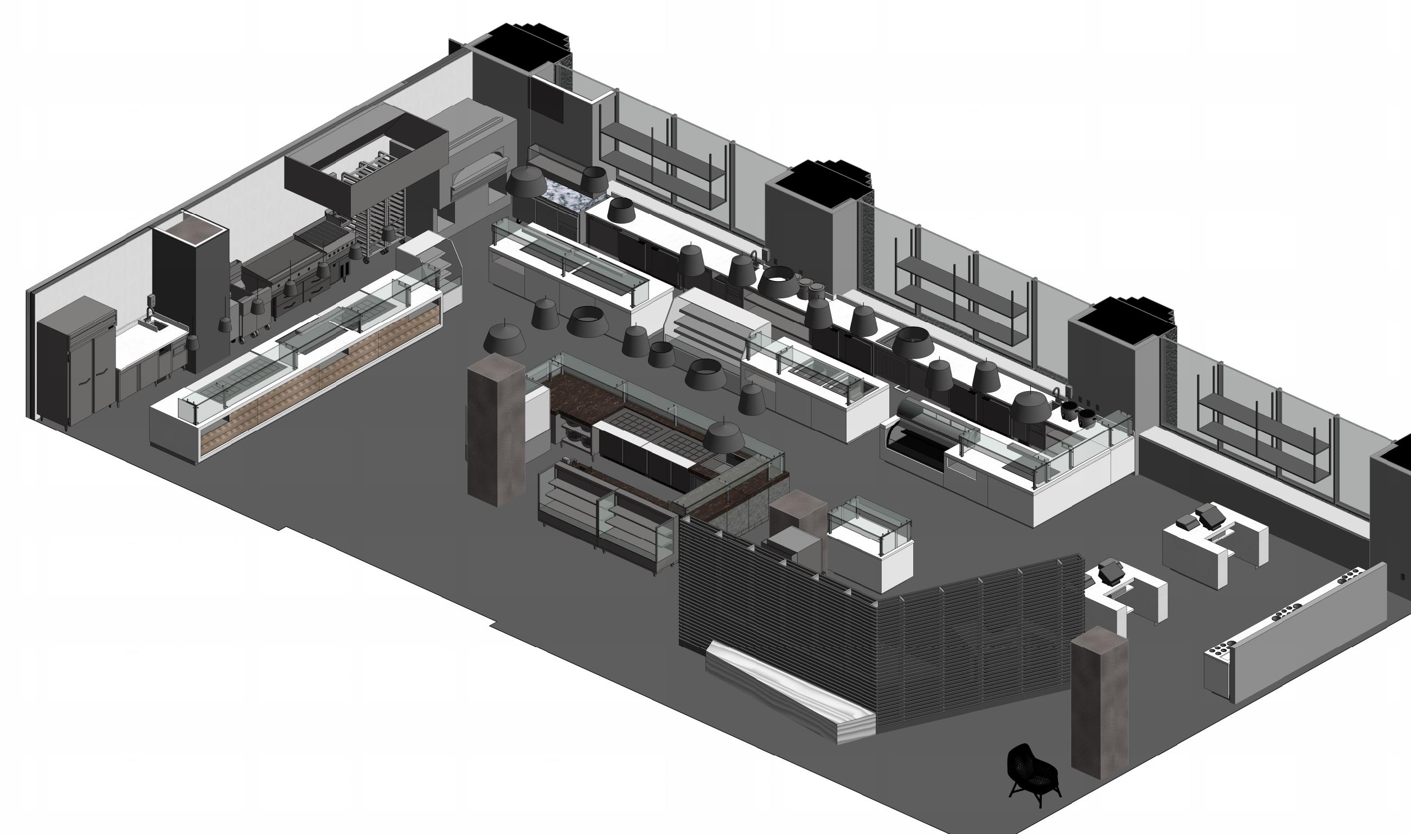
Getting to VR is easy, but what will you see when you get there?

Slide 10
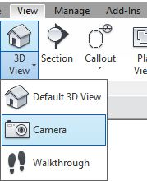
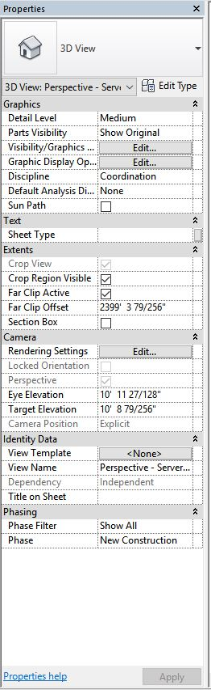
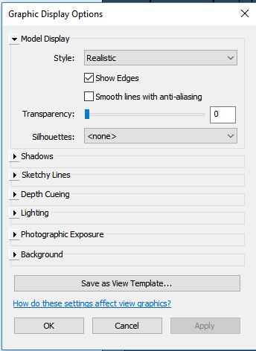
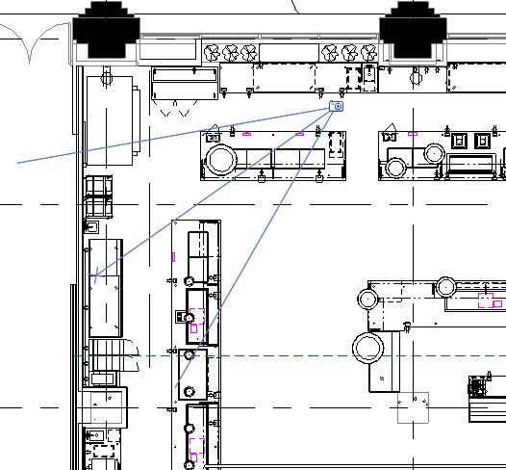

Revit Tip: Use Camera Views set to Realistic Style

Slide 11
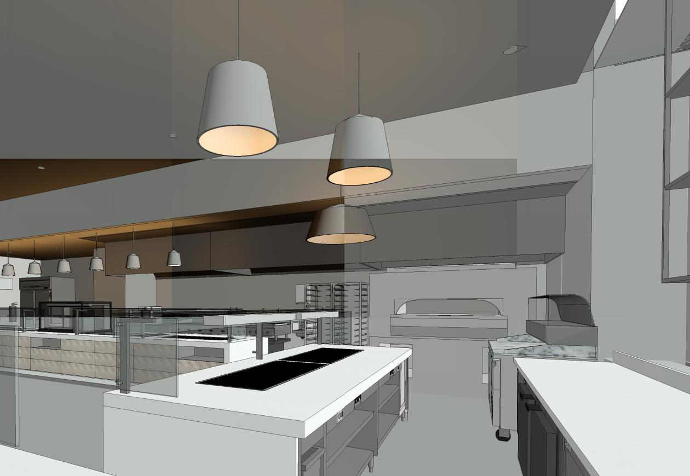
Revit Camera View (Realistic)

Slide 12
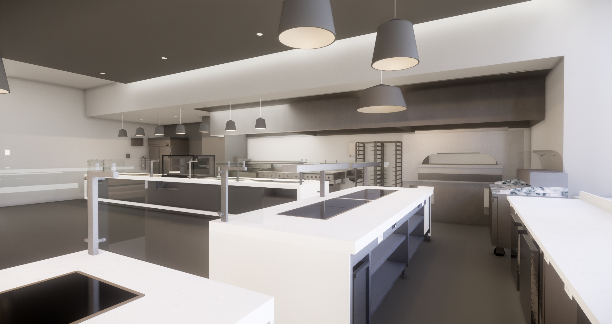
Enscape

Slide 13
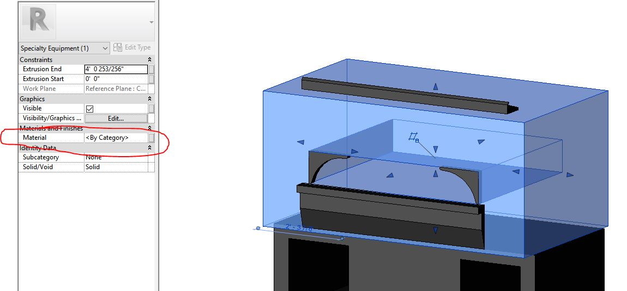
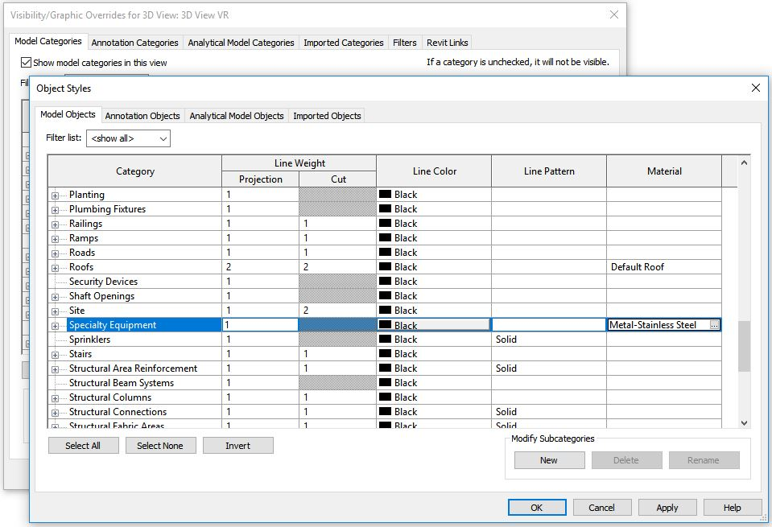
Revit Tip: Specify the Default
Specialty Equipment Material

Slide 14
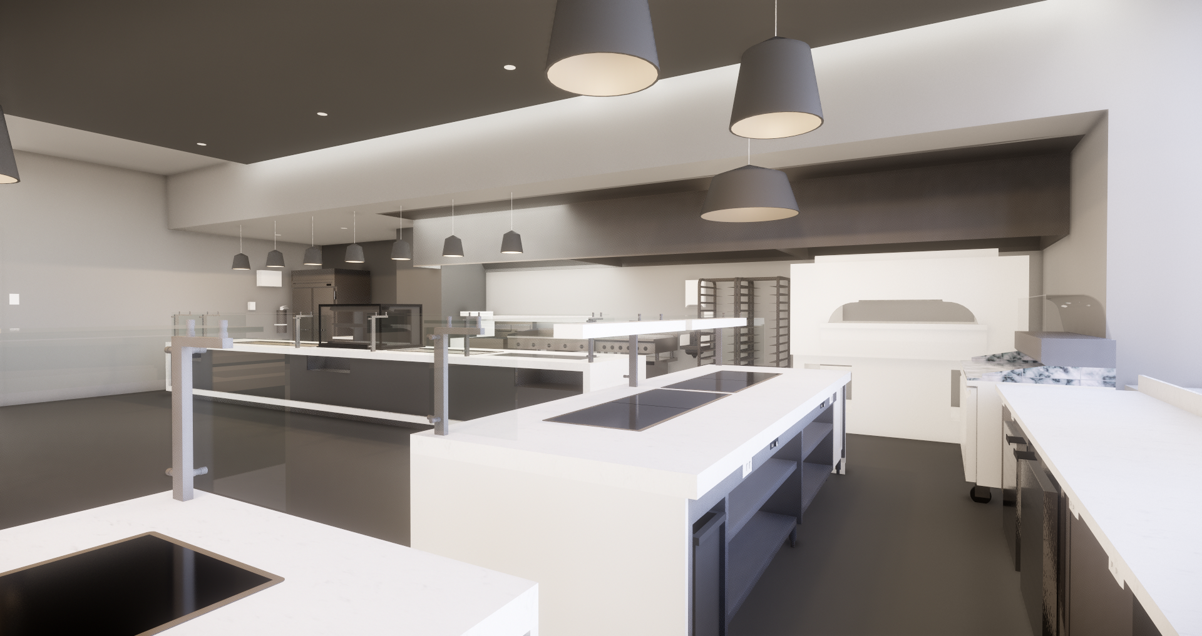
Enscape – Default Material Not Specified

Slide 15
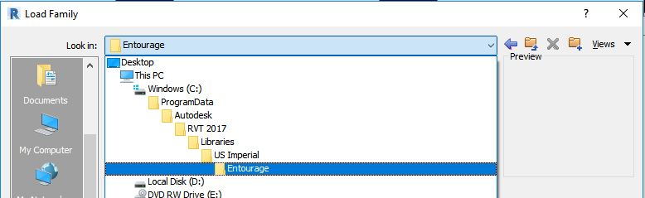
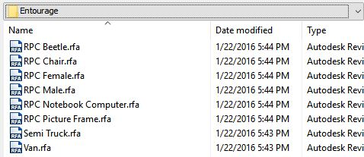
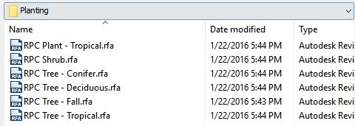
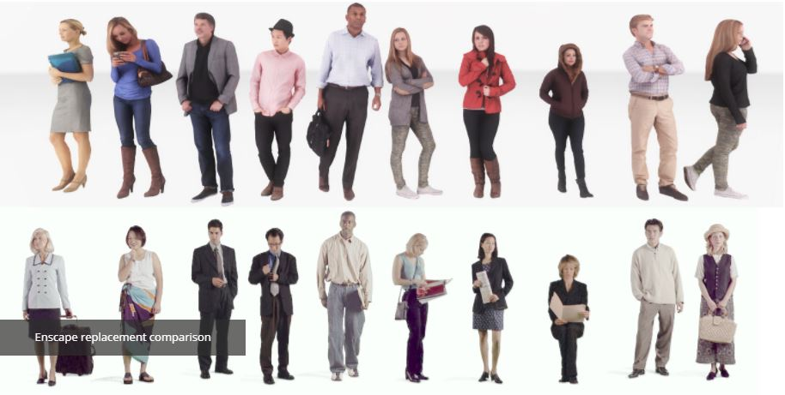

Revit Tip: Use Rich Photorealistic Content (RPC)
Enscape Free Replacements (top)
Free Entourage from Revit (bottom)

Slide 16
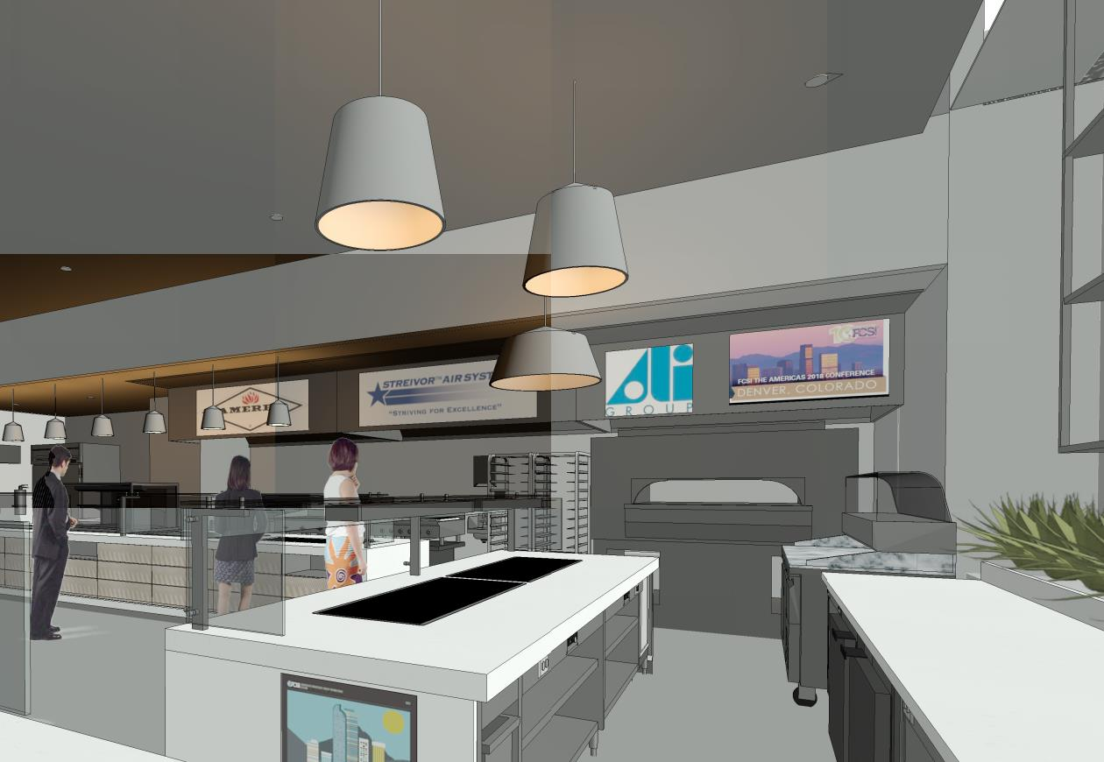
Revit Realistic With Decals & RPC

Slide 17
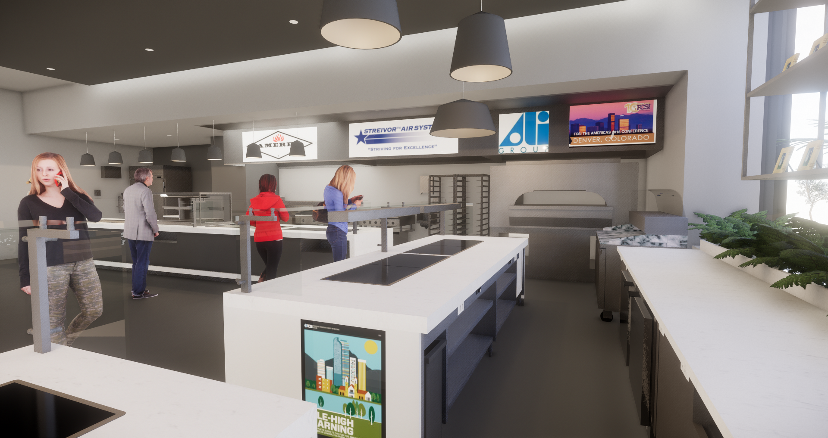
Enscape With Decals & RPC

Slide 18
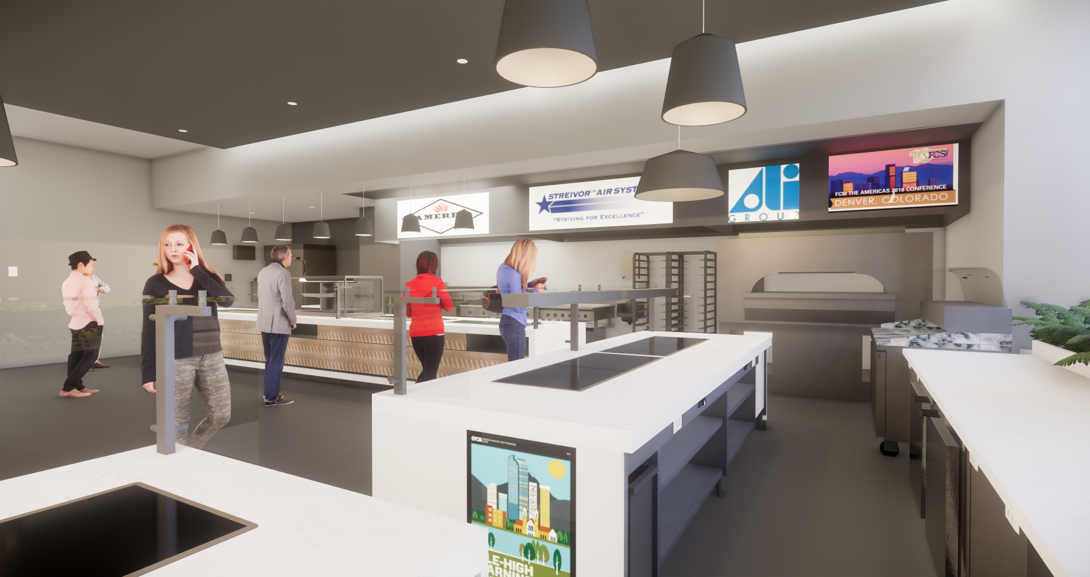
Enscape With Decals & RPC (With Tile Decals)

Slide 19
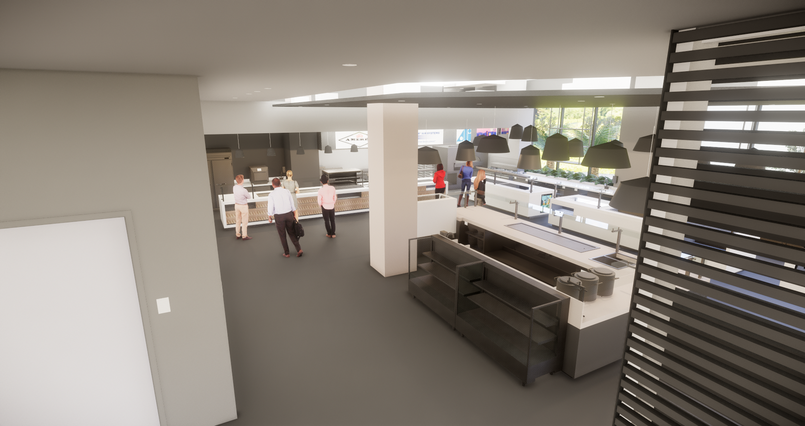
Enscape With Decals & RPC (With Tile Decals)

Slide 20
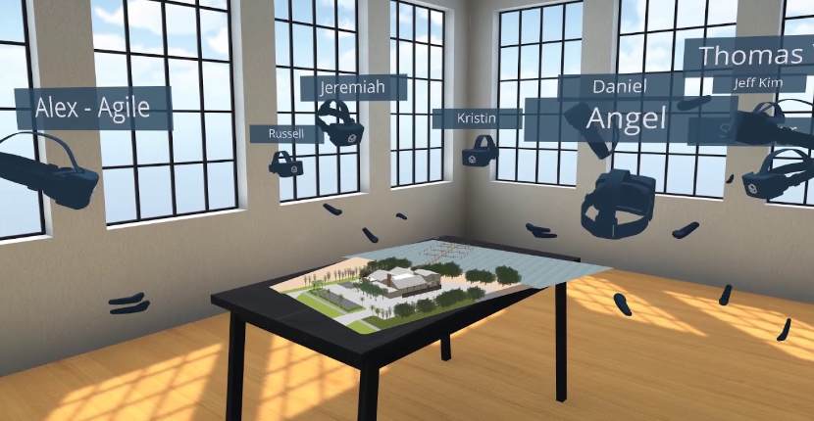
Collaborative VR (Group VR) with InsiteVR

Slide 21
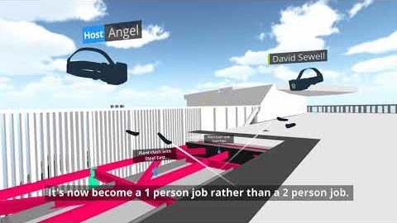
Collaborative VR (Group VR) with InsiteVR

Slide 22
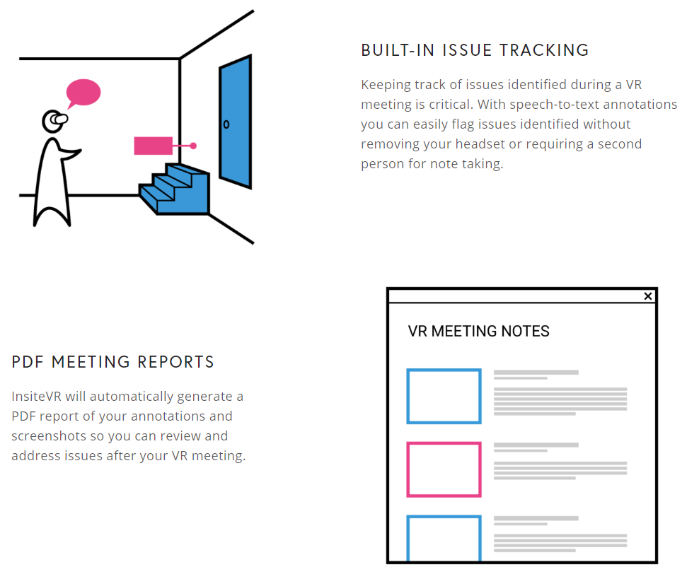
Collaborative VR (Group VR) with InsiteVR

Slide 23
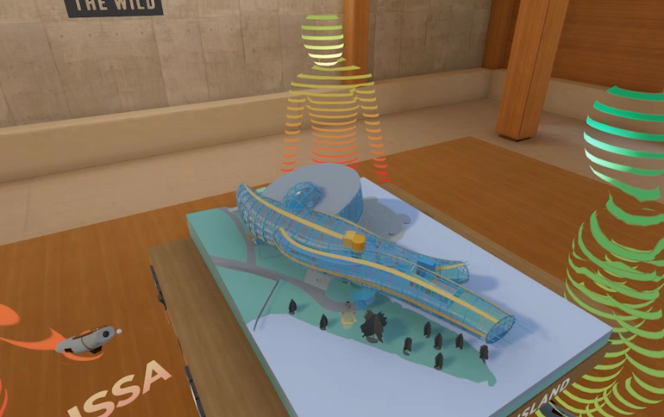
Immersive VR/AR with The Wild

Slide 24
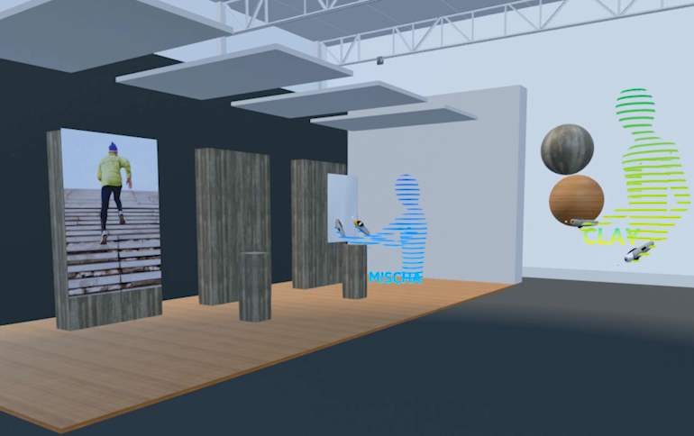
Immersive VR/AR with The Wild

Slide 25
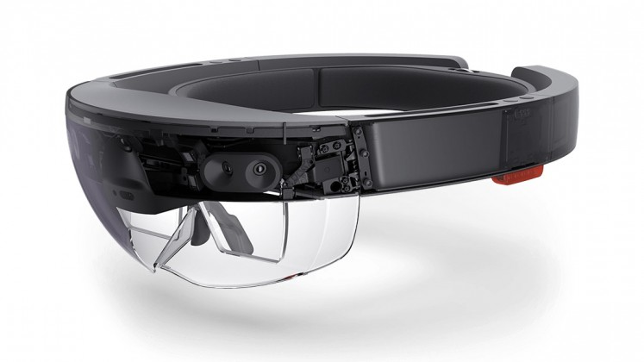
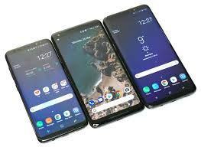
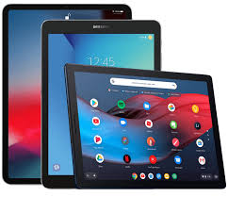
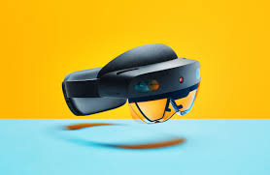
Augmented Reality Devices
HoloLens
HoloLens 2

Slide 26
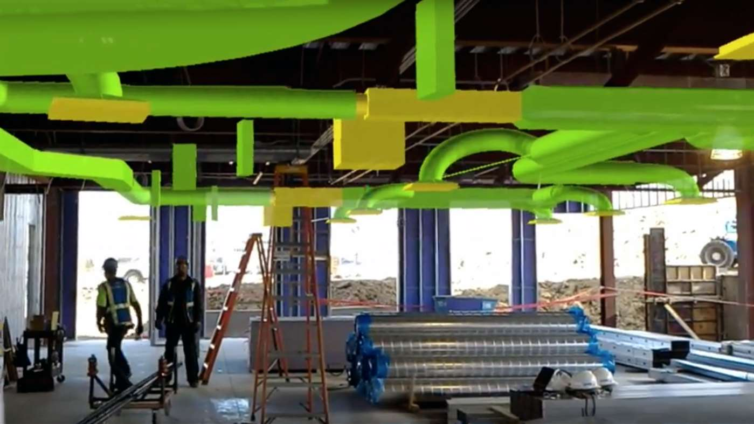

AR is already impacting AEC

Slide 27

VisualLive

Slide 28

AR Software for Revit - Kubity

